Slide 2
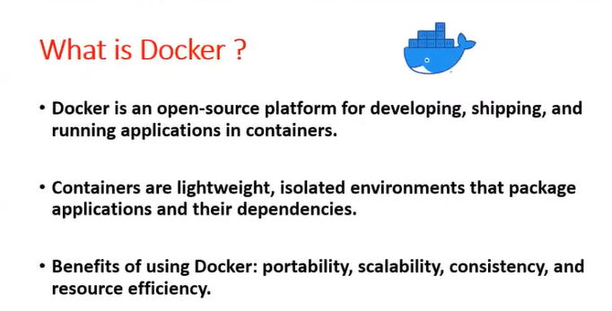

Slide 3
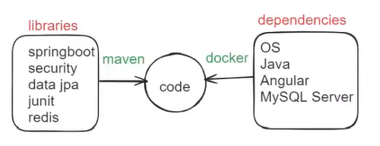

Slide 4
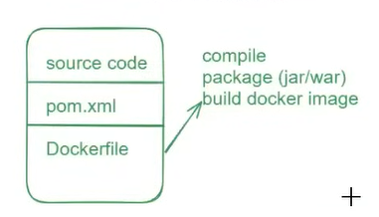

Slide 5
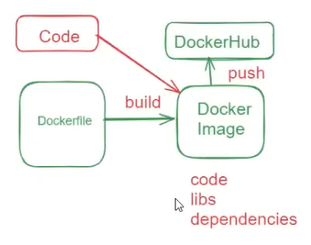

Slide 6
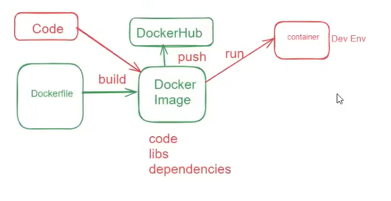

Slide 7
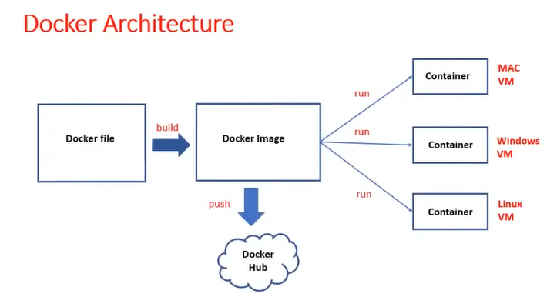

Slide 8
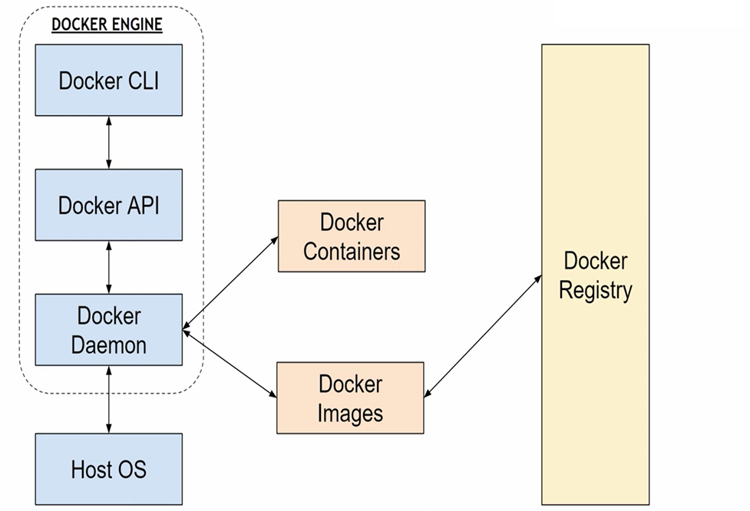

Slide 9
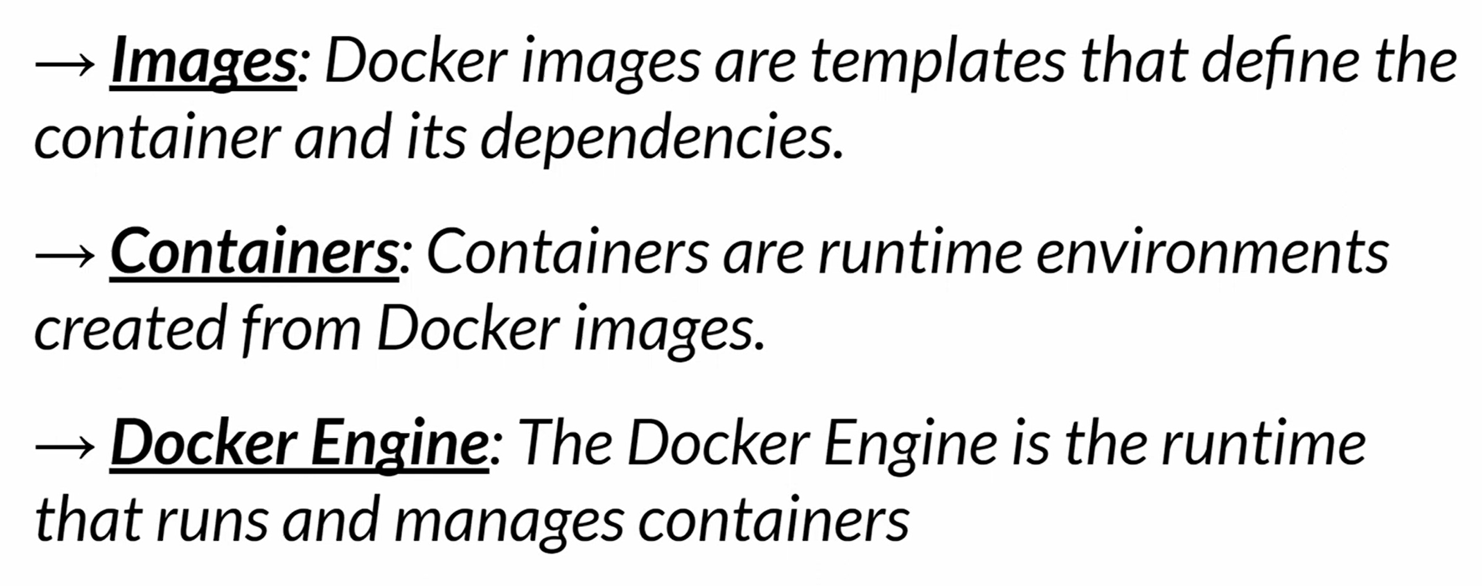

Slide 10
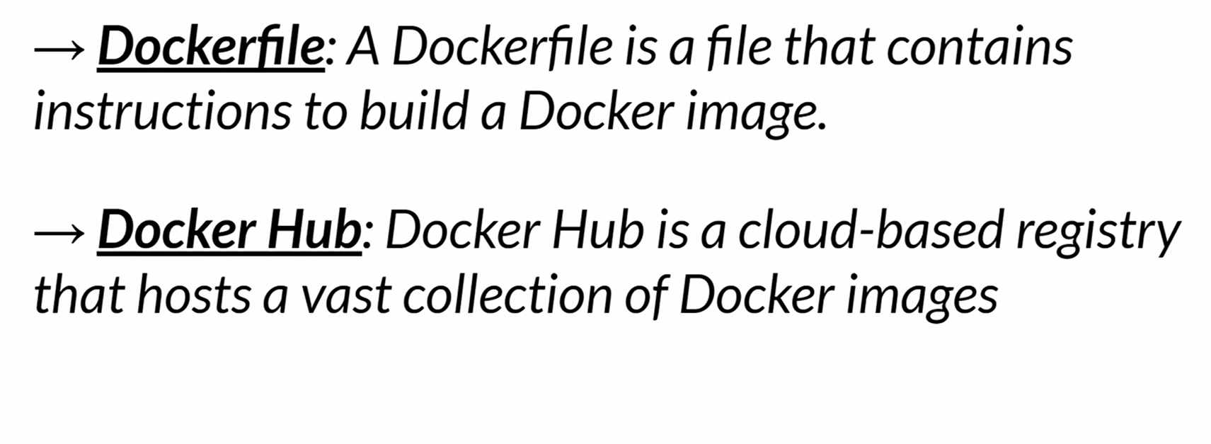

Slide 11
Docker Hub is a cloud-based repository service that allows users to store, share, and manage Docker container images.
Developers can package their apps and dependencies into lightweight, portable containers using the widely used Docker platform.

Slide 12
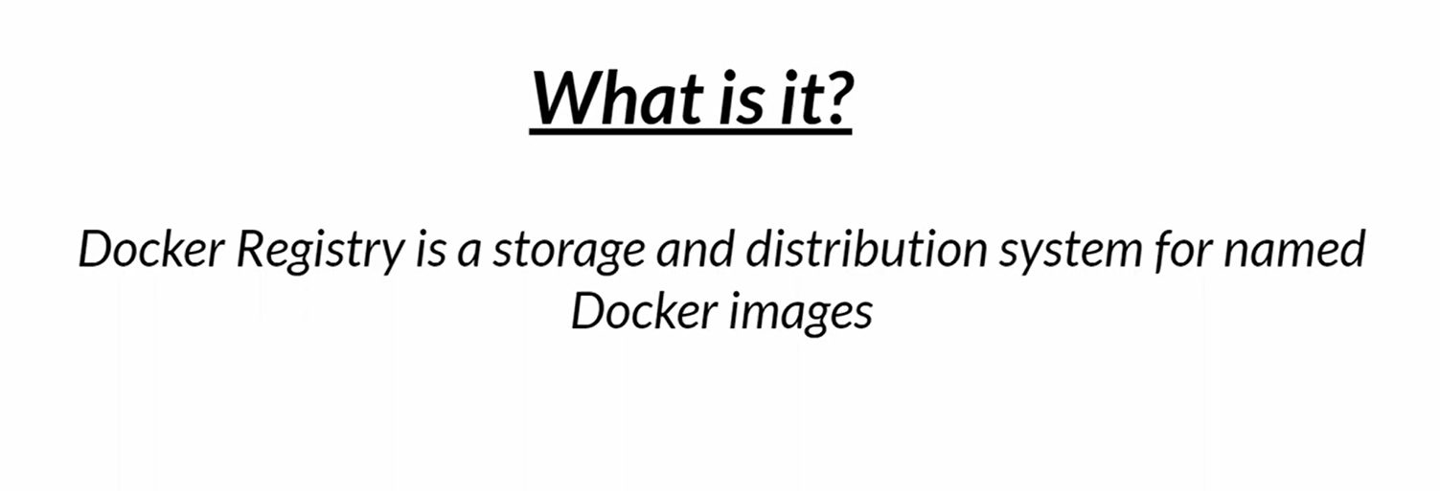

Slide 13
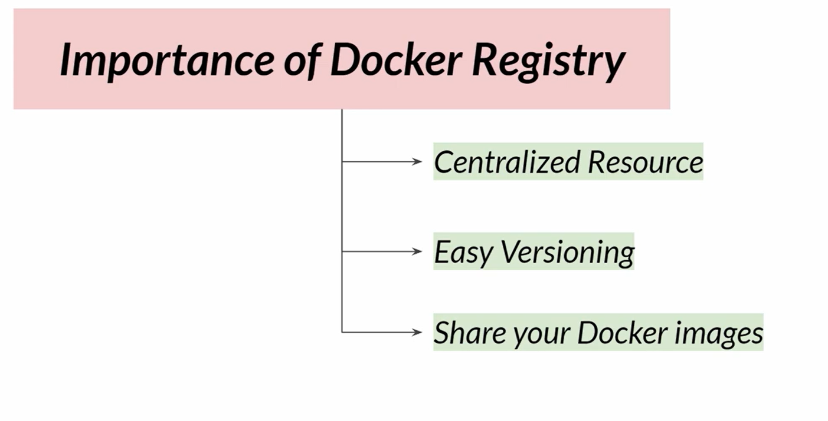

Slide 14

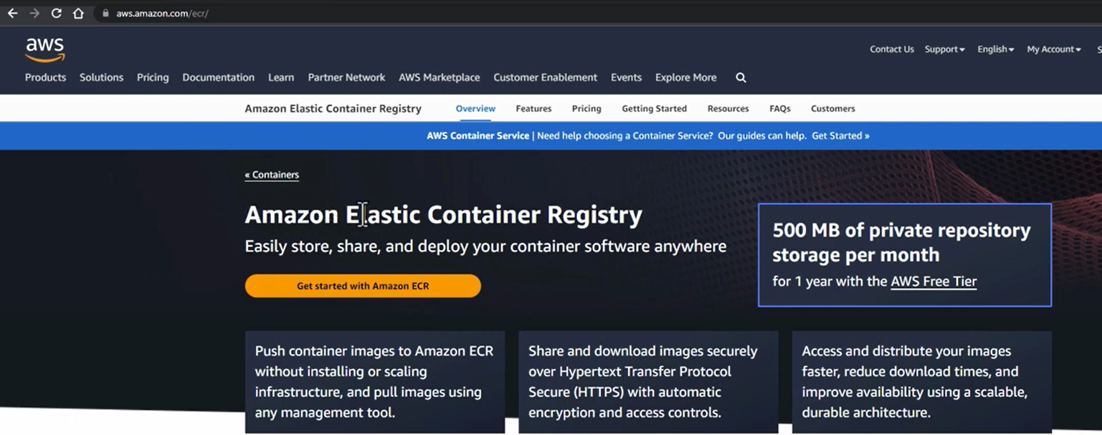

Slide 15
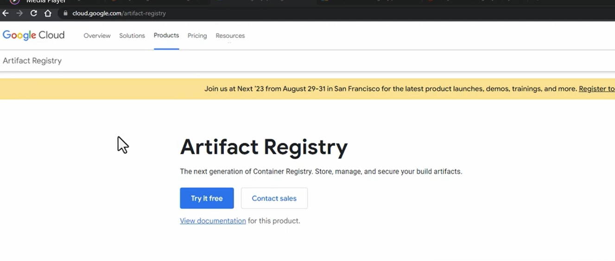

Slide 16
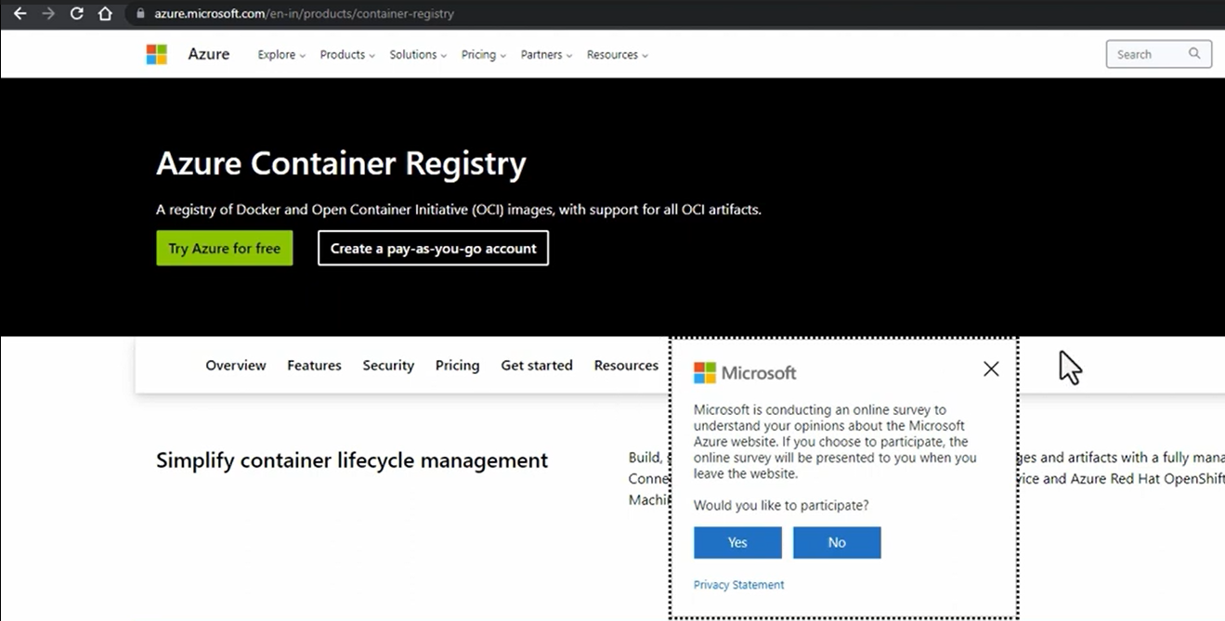

Slide 17
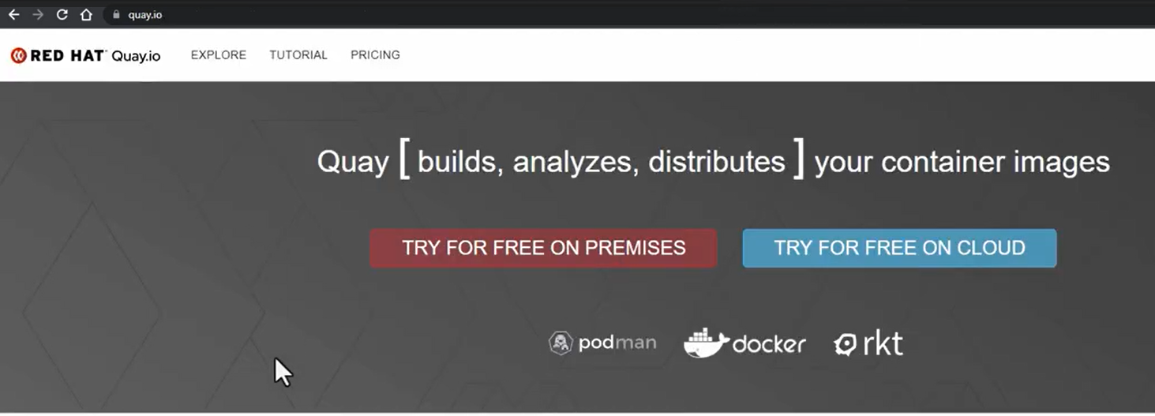

Slide 18
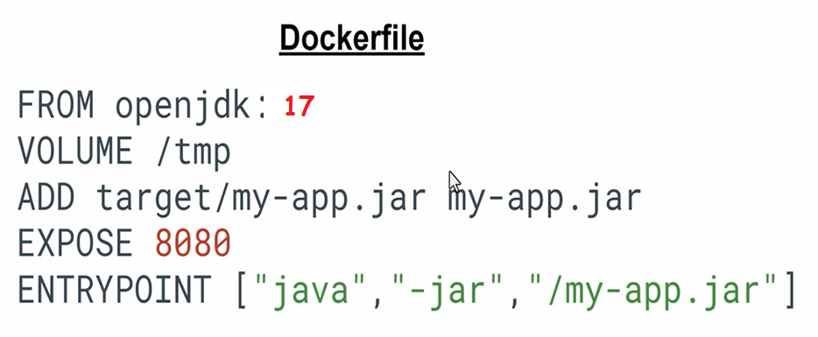

Slide 19
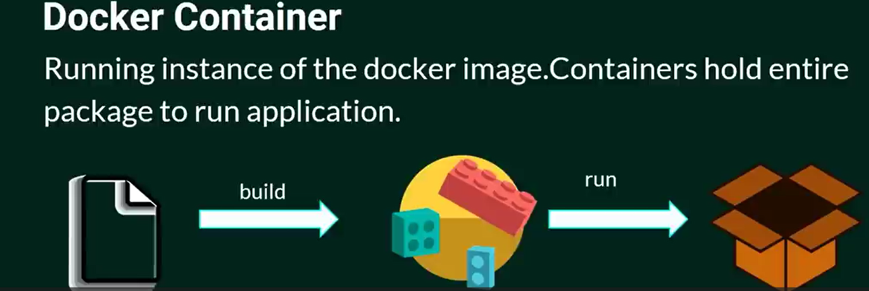
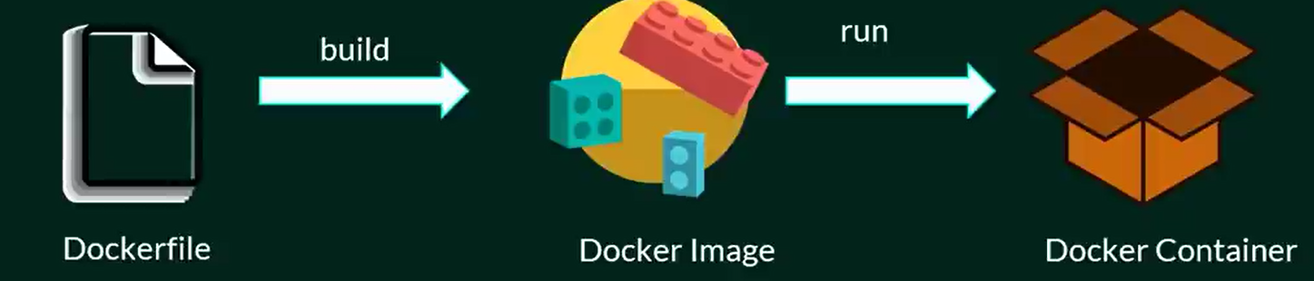

Slide 20
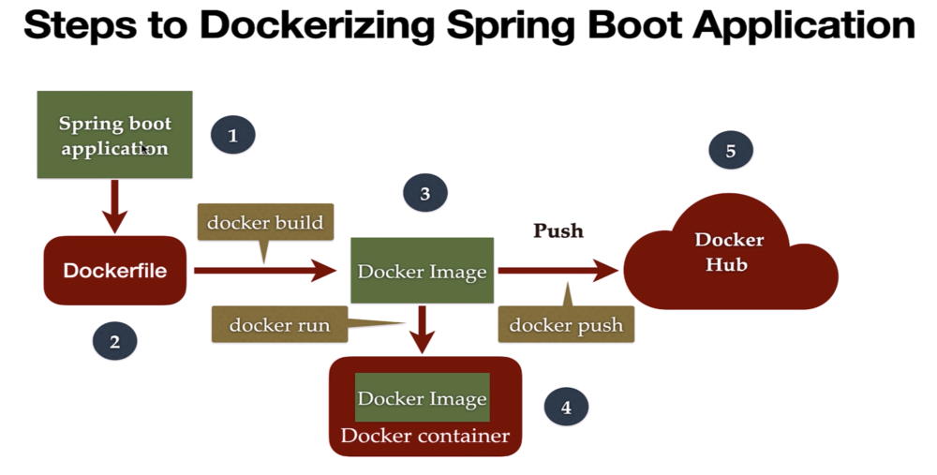

Slide 22
Amazon Elastic Container Registry (ECR)
Amazon Elastic Container Registry (ECR) is a fully managed Docker container registry integrated with AWS.
Integration with AWS − Deep integration with the broader AWS toolset, including ECS, EKS, and CodePipeline.
Scalability − It can scale in size and number of images stored.
Security − Provides image encryption, IAM for controlling access, and network integration.
Image Scanning − The images are scanned for software vulnerability through Amazon Inspector.
Cost-Effective − Pay-as-you-go pricing model with free tier options.

Slide 23
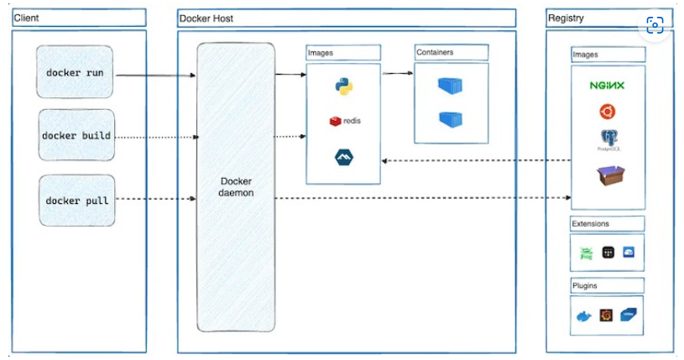
Docker - Architecture

Slide 24
Docker uses a client-server architecture. The Docker client communicates with the docker daemon, which does the heavy work of creation, execution, and distribution of docker containers.

Slide 25
There are two major components to public registries: Docker Hub and Docker Cloud. Private registries are also popular in organizations. The most popular commands for working with these storage areas are docker push, docker pull, and docker run.
Dockerhub, the official Docker registry, contains multiple official image repositories. A repository is a collection of similar Docker images that are uniquely identifiable by Docker tags.
Some of them are Nginx, Apache, Python, Java, Mongo, Node, MySQL, Ubuntu, Fedora, Centos, and so on.

